Slide 1
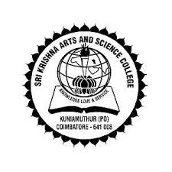
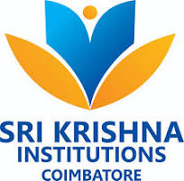
INDUSTRIAL EXPOSURE TRAINING
22ODE38
SRI KRISHNA ARTS AND SCIENCE COLLEGE
[An Autonomous Institution]
Ranked 33rd in NIRF; MHRD: 1st in Institutional Swachhata Ranking
Coimbatore – 641 008
A REPORT ON
GRC CONSTRUCTIONS PVT LTD
By
SANJAY S
22BAF142
III BCOM AF B
Guide
Ms. JENIFER.V
ASSISTANT PROFESSOR

Slide 2

GRC CONSTRUCTIONS COMPANY
INTRODUCTION:
G.Ramamoorthi Constructions India Private Limited is a leading civil construction company based in Coimbatore. Established in 1990 as G.Ramamoorthi & Co., the company was reconstituted as G.Ramamoorthi Constructions India Private Limited on July 14, 2008.
Since our inception, we have successfully executed numerous prestigious and challenging projects, including hospitals, educational institutions, industrial buildings, commercial complexes, and residential apartments.
Our Managing Director, Mr. G. Ramamoorthi, holds a B.E. in Civil Engineering and is a Member of the Institution of Engineers (M.I.E). With professional experience gained from working in the Gulf, Mr. Ramamoorthi brings a wealth of expertise and a commitment to excellence in every project we undertake.
At G.Ramamoorthi Constructions, we are dedicated to delivering high-quality construction services that meet the evolving needs of our clients and contribute to the growth and development of the communities we serve.

Slide 3
COMPANY PROFILE
Company Name: G.Ramamoorthi Constructions India Private Limited
Established: 1990 (as G.Ramamoorthi & Co.), Reconstituted on July 14, 2008
Location: Coimbatore, India
Founder : Mr. G. Ramamoorthi, B.E. (Civil), M.I.E.
Managing Director: Mr. R. Arun Ramamoorthi, B.E. (Civil)
Overview: G.Ramamoorthi Constructions India Private Limited stands as a prominent civil construction company in Coimbatore, with a rich history dating back to 1990. Initially founded as G.Ramamoorthi & Co., the firm evolved into its current structure in 2008, reflecting our growth and expanded capabilities.

Slide 4



Our Expertise: We pride ourselves on successfully executing a diverse range of prestigious and challenging projects. Our portfolio includes:
Hospitals
Educational Institutions
Industrial Buildings
Commercial Complexes
Residential Apartments
Leadership: Our Managing Director, Mr. G. Ramamoorthi, brings a wealth of knowledge and international experience to our company. With a Bachelor's degree in Civil Engineering and membership in the Institution of Engineers (India), he leverages his professional background gained from working in the Gulf to drive our commitment to quality and innovation.
Mission: At G.Ramamoorthi Constructions, our mission is to deliver high-quality construction services that exceed our clients' expectations. We are dedicated to contributing to the growth and development of the communities we serve by creating durable, functional, and aesthetically pleasing structures.
Vision: To be a leading construction company renowned for our integrity, excellence, and ability to tackle complex projects, thereby setting benchmarks in the construction industry.

Slide 5
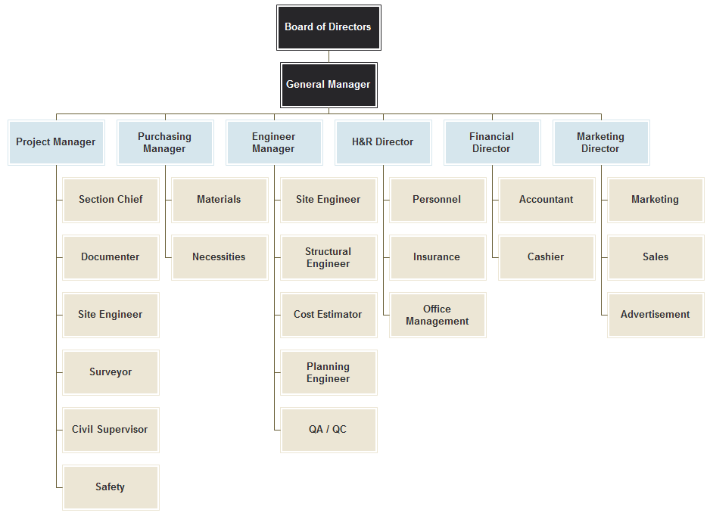
ORGANIZATIONAL STRUCTURE

Slide 6
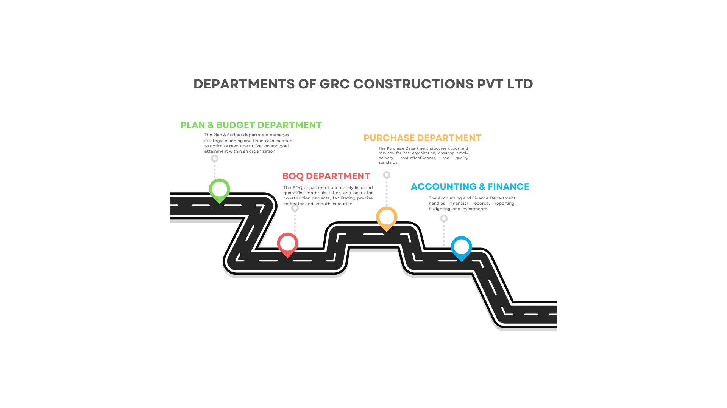
DEPARTMENT PROFILE

Slide 7
ACCOUNTING AND FINANCE DEPARTMENT
ACCOUNTING DEPARTMENT
Bill Checking
The Accounting and Finance Department at G.Ramamoorthi Constructions India Private Limited (GRC) is essential for ensuring the company's financial stability and integrity. It handles bill checking, verification, approval, cheque issuance, and voucher creation. The department records all financial transactions, maintains comprehensive records, and prepares profit or loss statements, ensuring accurate financial reporting and compliance. Led by experienced professionals, it supports budgeting, financial planning, and auditing. By fostering transparency and accountability, the department upholds high financial management standards and contributes significantly to GRC's overall success.
Bill Verification
Bill Verification
Bill Approval
Cheque Issuance
Bill Voucher Creation
Journal Entries
Profit or Loss Statement

Slide 8
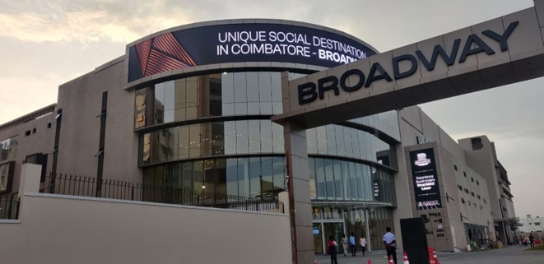
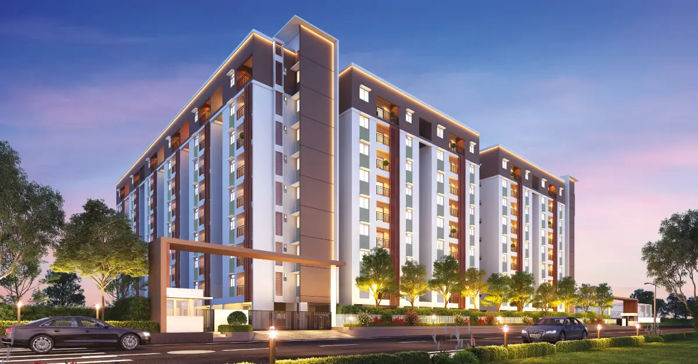
COMPLETED PROJECTS
CLIENT: Broadway Megaaplex
Name of the Project : Broadway Mall
Build up Area : 3.60 Lakhs
Peroid: March 2021
CLIENT: Emerald Haven Realty Ltd, Chennai
Name of the Project : Apartment 3 Blocks
Build up Area : 1.60 Lakhs Sft
Peroid: 2019 -2022

Slide 9



APPLICATION OF THE TECHNOLOGY
Tally Prime is a comprehensive financial management solution trusted globally. It streamlines accounting by automating tasks such as transaction recording, ledger management, and financial reporting. With a user-friendly interface and robust features, it suits businesses of all sizes. Tally Prime also offers inventory management, tax compliance, payroll processing, and invoicing, making it a versatile finance management tool.
BSF software is a custom or proprietary solution designed to streamline an organization's purchase management processes. It includes features like vendor management, purchase order creation, inventory tracking, and invoice processing. By centralizing purchase-related activities, BSF helps optimize procurement processes, reduce costs, and improve efficiency.
Zoho Mail is a comprehensive communication platform that goes beyond email hosting. It allows businesses to create professional email addresses with their domain names, enhancing credibility and brand identity. Its intuitive interface and powerful features like email filtering and custom folders help manage inboxes efficiently. Zoho Mail also integrates seamlessly with other Zoho applications, providing a unified platform for communication and collaboration.

Slide 10
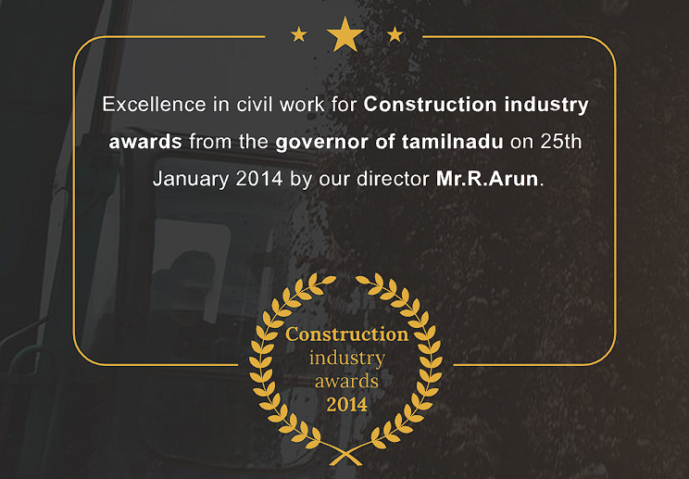
AWARDS AND ACHIEVEMENTS
G.Ramamoorthi Constructions India Private Limited was awarded the "Excellence in Civil Work" accolade by the Governor of Tamil Nadu on January 25th, 2014. This prestigious recognition celebrates the company's exceptional performance in the civil construction sector, highlighting its commitment to quality, innovation, and safety standards. The award, received by Director Mr. R. Arun, underscores the company's esteemed reputation and dedication to excellence. It serves as motivation for the team to maintain superior quality and innovation in future projects, reaffirming G.Ramamoorthi Constructions’ commitment to industry standards and customer satisfaction.

Slide 11
SWOT ANALYSIS
Strengths:
G.Ramamoorthi Constructions is led by experienced professionals, renowned for delivering high-quality projects and embracing innovation. Their diverse portfolio showcases versatility, while their commitment to safety and compliance ensures a reputable standing in the industry.
Weaknesses:
Predominantly operating in Coimbatore and Chennai, the company may face limitations in market exposure. Dependency on key personnel and challenges in scaling operations efficiently are also areas of concern.
Opportunities:
Opportunities lie in expanding into new geographic regions, forging public-private partnerships, capitalizing on sustainable construction trends, and leveraging technological advancements.
Threats:
Economic fluctuations, regulatory changes, intense competition, and supply chain disruptions pose potential threats to the company's operations and profitability.

Slide 12
CORPORATE SOCIAL RESPONSIBILITY
At G.Ramamoorthi Constructions India Private Limited (GRC), corporate social responsibility (CSR) is a cornerstone of the company's values. Led by Mr. G. Ramamoorthi, GRC has initiated impactful CSR projects to benefit the community and promote educational development.
Land Donation for Government School: Mr. G. Ramamoorthi donated 2 acres of land in Elachipalayam to establish a government school, enhancing educational infrastructure and accessibility for underprivileged children.
School Maintenance and Facility Upgrades: GRC adopted the government school, ensuring its maintenance and cleanliness. Modern toilet facilities were constructed, improving sanitation standards and benefiting the students and staff.
Scholarship Program for Outstanding Students: GRC offers scholarships to students achieving high marks in their examinations, fostering academic excellence and motivation among youth.

Slide 13
CONCLUSION
In summary, G.Ramamoorthi Constructions India Private Limited (GRC) is a renowned leader in the construction industry, known for its commitment to excellence and integrity. Led by Mr. G. Ramamoorthi, the company has a rich legacy of delivering high-quality projects across various sectors. Through innovative solutions and a focus on customer satisfaction, GRC has earned the trust of clients. Moreover, GRC's dedication to corporate social responsibility is evident through impactful initiatives aimed at community development and educational empowerment. With a strong foundation of values and a vision for the future, GRC continues to set new standards of excellence in the construction sector.

